Slide 1
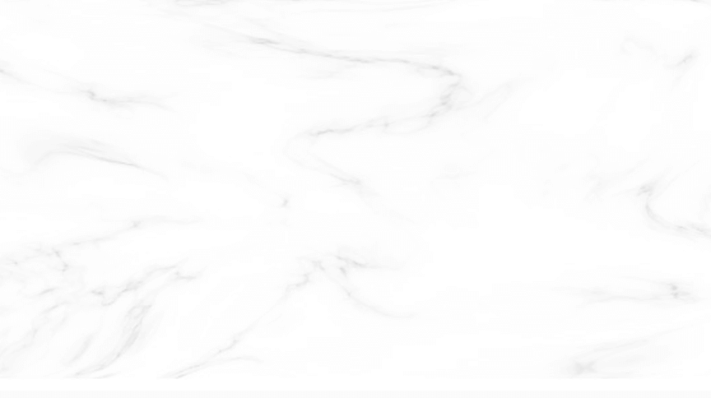
Guanyu Zhou
Mobile Price Classification
4/27/4022

Slide 2
Mobile Price Classification
Part 01
Executive Summary
Find the best machine learning model/method for mobile dataset
Data Understanding
Part 02
Part 03
Exploratory Data Analysis
Part 04
Conclusion

Slide 3
A.
Executive Summary
This is a mobile price classification dataset from Kaggle.
The goal of this project is to find the best model to predict our target.
The three methods will be used:
"i": Classifier methods
"ii": Ensemble method
"iii": Deep learning, neural network method

Slide 4

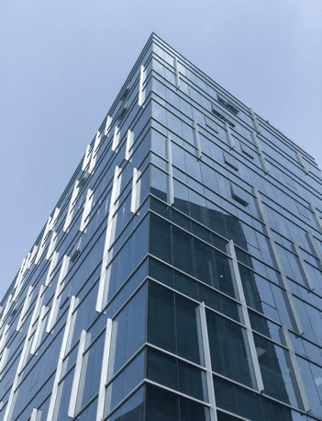
Data Understanding
https://www.ypppt.com/
Mobile Price Dataset
Target: mobile price range
Features: mobile's battery power, mobile weight, mobile cores and etc.
2000
21
rows
features

Slide 5
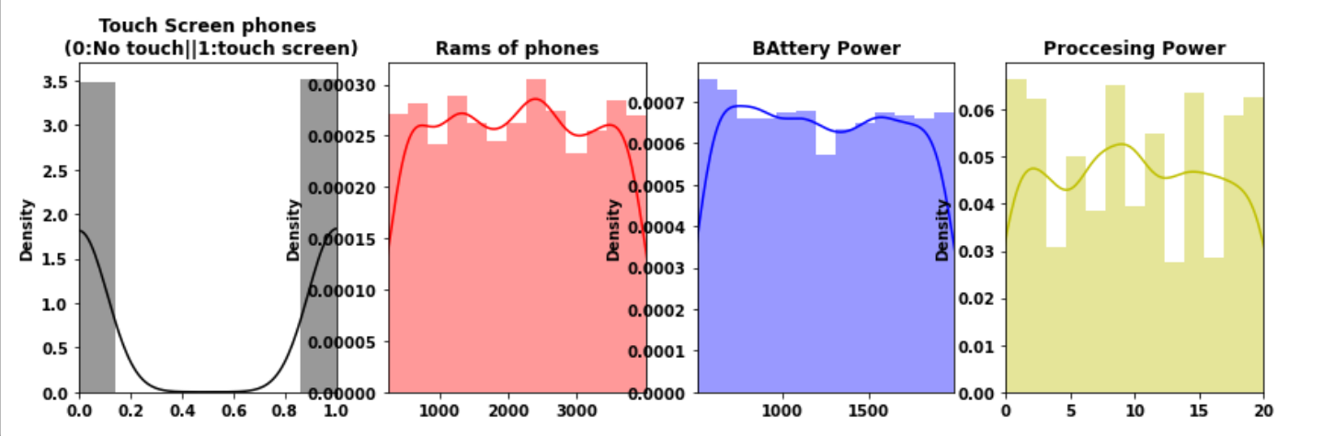
Data Understanding
https://www.ypppt.com/
Variables Distribution
Features:
Touch Screen phones: Balanced
Rams of phones: Balanced
Battery power: Balanced
Processing power: Balanced
标题文内容
标题文字内容
ENTER THE TITLE HERE

Slide 6
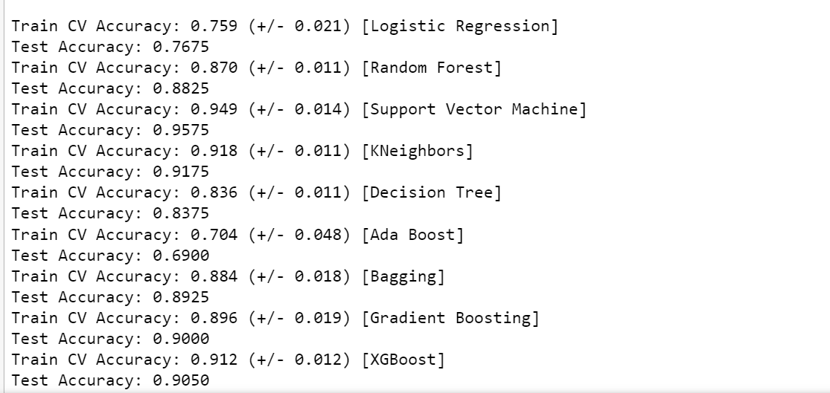
"i": Classifier methods
https://www.ypppt.com/
5-Fold Cross Validation
Target: mobile price range
Features: mobile's battery power, mobile weight, mobile cores and etc.
SVM
0.9575
9
Classifiers
BEST
BEST

Slide 7
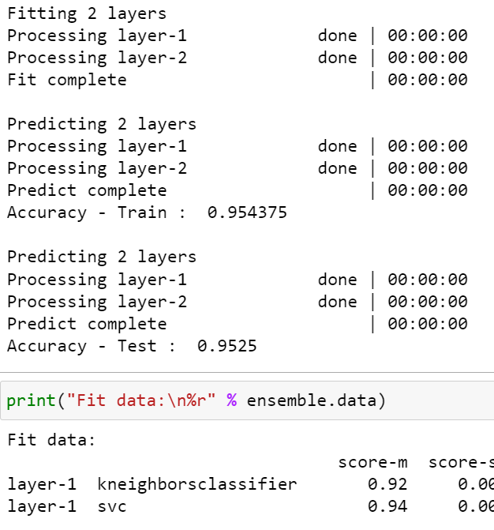
"ii": Ensemble method
https://www.ypppt.com/
ML-Ensemble library
Target: mobile price range
Combine models from previous classifiers:
My best mode: SVM 0.9575
My second-best model: KNN 0.9175
Ensembles
SVM
KNN
0.9525
TOGETHER

Slide 8
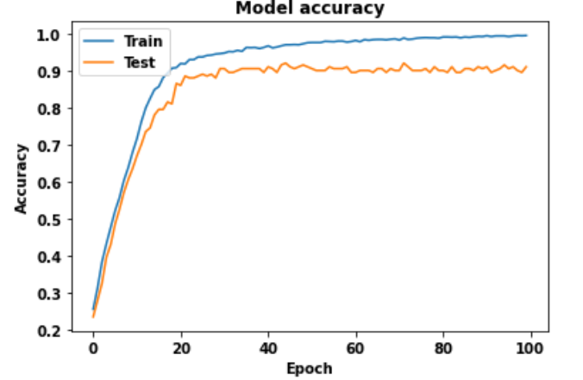
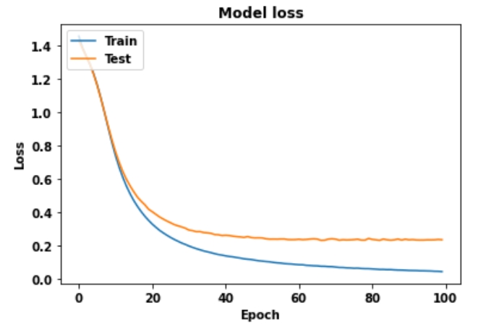
"iii": Neural Network
https://www.ypppt.com/
Tensorflow
Target: mobile price range
First layer: Output 16 dimensions, while input is 20 dimensions.
Second Layer: Output 12 dimensions.
Last layer: Output 4 dimensions, as target has 4 different classes.
NN
0.9100
2 Dense layer: Relu
1 Output layer: Softmax
Accuracy
Loss

Slide 9
Conclusion
https://www.ypppt.com/
Find the best model
Target: mobile price range
"i": Classifier methods: The BEST model we find is "support vector machine“. Test Accuracy: 0.9575
"ii": Ensemble method : The best 2 models from classifier methods we found, SVM+KNN. Test Accuracy: 0.9525
"iii":Deep Learning, Neural Network method: Test Accuracy: 0.9100
SVM
SVM
SVM
0.9575
Best

Slide 10
THANKS

